Slide 1

Week 4: Cloud and API deployment
Iris Flower Species Prediction Deployment
Virtual Internship
Batch: LISUM25
Supin Hooda
27-Sep-2023

Slide 2
Introduction
Project Purpose: The primary goal of this project is to demonstrate how a machine learning model, trained on the Iris dataset from Kaggle, can be deployed using Flask for real-time predictions.
Dataset Source: The dataset used in this project is the well-known Iris dataset, sourced from Kaggle. It comprises various measurements of Iris flowers, along with their species labels.
Machine Learning Model: We have employed a Random Forest Classifier, a robust ensemble learning technique, to build the predictive model. Random Forest is known for its accuracy and versatility in classification tasks.

Slide 3
Data Selection
The dataset contains four features (sepal length, sepal width, petal length, and petal width) and a target variable (variety).
Kaggle link for dataset https://www.kaggle.com/datasets/saurabh00007/iriscsv/

Slide 4
Feature Scaling
Importance of Feature Scaling:
Feature scaling is crucial in machine learning to ensure that all input features have the same scale. In our project, we have used the StandardScaler from scikit-learn to scale the features.
Scaling is important because it helps the machine learning model converge faster during training, especially when gradient descent-based algorithms are involved.
StandardScaler scales features to have a mean of 0 and a standard deviation of 1, making them more comparable and avoiding the dominance of certain features.
Scaling Techniques Applied:
In our project, we applied the StandardScaler, which standardizes features by removing the mean and scaling them to unit variance. This technique is suitable for our dataset and model.

Slide 5
Model Creation
Choice of Model:
We chose the Random Forest Classifier for this task because of its ability to handle both classification tasks and feature importance ranking.
Random Forest is an ensemble learning technique known for its accuracy, robustness, and resistance to overfitting.
Hyperparameters and Settings
We used default hyperparameters for simplicity in this project. However, Random Forest allows tuning hyperparameters for better performance, if needed.

Slide 6
Model Training
Importance of Model Training:
- Model training is a critical step in machine learning. It involves fitting the model to the training data, allowing it to learn patterns and make predictions.
- During training, the model adjusts its internal parameters to minimize prediction errors and improve its ability to generalize to unseen data.
-Role of Training Data:
- The training data serves as the foundation for building a predictive model. It contains labeled examples that the model learns from, enabling it to make accurate predictions on new, unseen data.

Slide 7
Model Saving
Reason for Model Saving:
- We save the trained model using pickle to preserve its state for future use without the need to retrain it.
- This allows us to deploy the model in a web application, making real-time predictions without the training overhead.
Filename Used:
- The saved model is stored as "iris_model.pkl," which can be loaded and used in the Flask web application.

Slide 8
Flask Web App Development
Purpose of the Web App:
- The web app serves as an interface for users to interact with our trained model. Users can input feature values, and the app will provide predictions for the Iris flower species.
- Flask enables us to deploy machine learning models in a user-friendly way.
Route Definitions:
- Our Flask app defines two routes: "/" for the home page and "/predict" for receiving input data and returning predictions.

Slide 9
Running the Flask App
Importance of Running the App:
- Running the Flask app is crucial to make the model predictions accessible to users.
- It allows the app to listen on a specific port and handle incoming requests. In our case, we run it in debug mode for development and testing.
Web App Testing
- Predict Route:
- The "/predict" route of the web app connects to the trained model, making real-time predictions based on user input.
- Users can interact with the app to obtain predictions for Iris flower species.

Slide 10
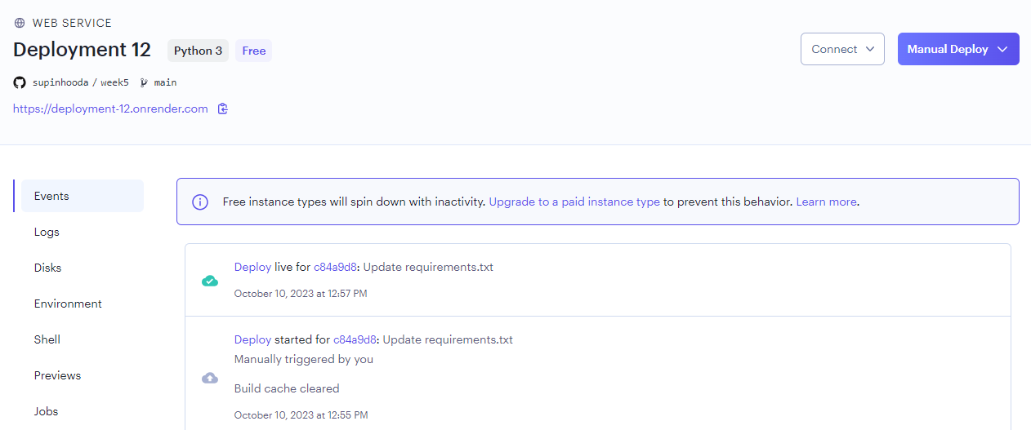
Cloud deployment- Render
Running the App:
https://deployment-12.onrender.com
gunicorn model_deployment:app

Slide 11
Conclusion
In conclusion, we successfully deployed a machine learning model for Iris flower species prediction using Render.
The process involved feature scaling, model creation, training, and saving the model for future use.
Our project showcases the successful integration of a machine learning model into a user-friendly web application, making predictions accessible to a broader audience.

Slide 12
Thank You

